Slide 1

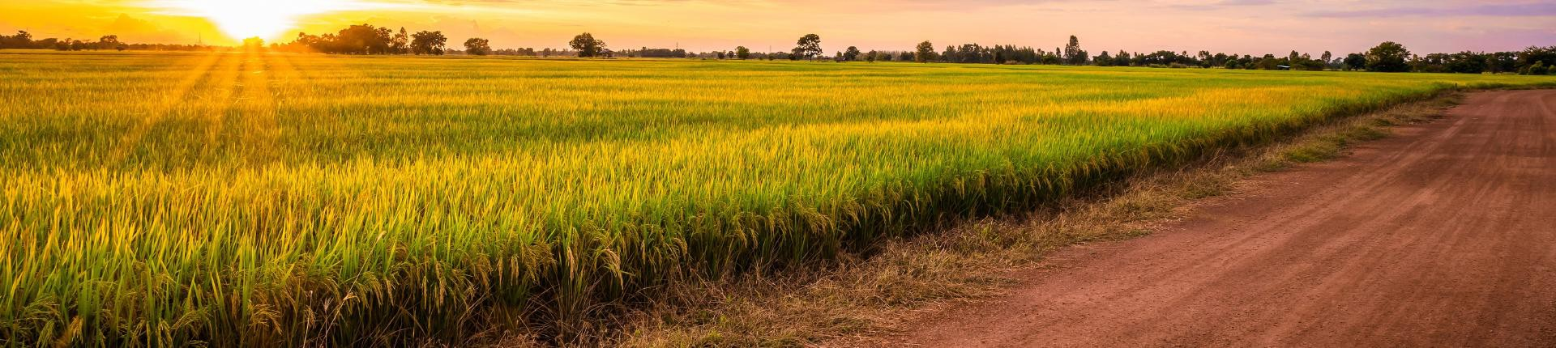



SPONSORSHIP PROPOSAL

Slide 2

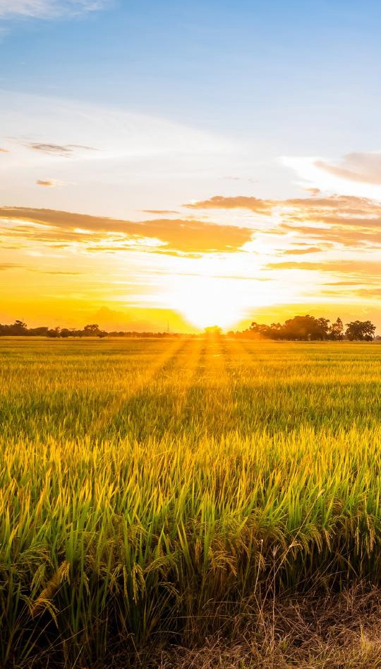
INAUGURAL PGP UKUKHULA
CONFERENCE 2025
PGP – the voice of the grain farmer – is proud to host the
inaugural Grain & Livestock Farmer Development Conference, taking place on 2 October 2025.
This landmark event represents a bold step forward strengthening the role of black commercial and developing producers within South Africa’s agricultural landscape. It is more than a gathering – it is a platform for growth, knowledge-sharing, and collaboration, forming a cornerstone for sustainable land reform and agricultural success.
Recognising the vital role of livestock in grain farming operations, this year’s programme also includes a strong livestock component. By bringing together grain and livestock perspectives, the Ukukhula Conference promises a truly comprehensive dialogue on building resilient, profitable, and inclusive farming enterprises.

Slide 3
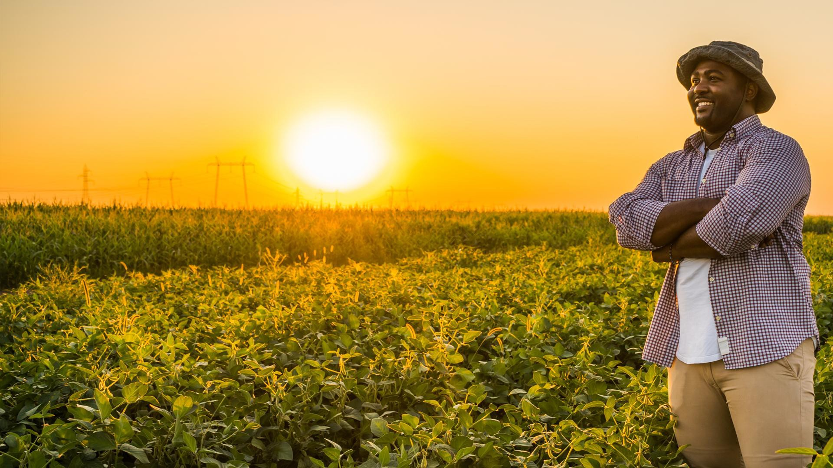
WHY “UKUKHULA”?
Ukukhula means “growth” in isiZulu and
isiXhosa. It reflects not only the growth of crops and livestock, but also the growth of farmers, communities, and the agricultural economy. The Ukukhula Conference symbolises a collective commitment to transformation, sustainability, and a thriving future for South African farming.

Slide 4
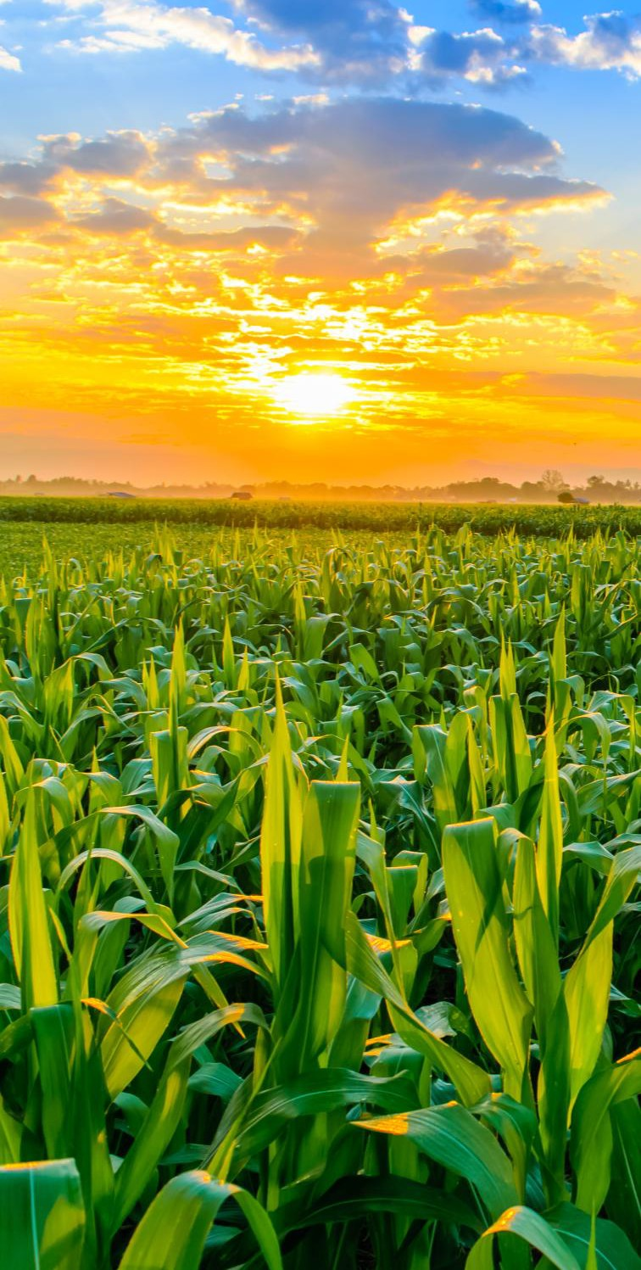
CONFERENCE THEME
The PGP Ukukhula Conference embraces the theme “Setting the Pace for the Farmer.”
It calls on farmers to move forward with purpose and speed, tackling challenges through practical solutions and bold innovation.
This inaugural gathering aims to unite farmers, leaders, and stakeholders to spark collaboration, mentorship, and transformation – laying the foundation for an annual platform that drives inclusive growth in South African agriculture.

Slide 5

CONFERENCE STRUCTURE
AT A GLANCE
Opening Session – National insights, sector challenges, and the way forward.
Commercial Development Farmers – Focusing on growth and
opportunities for commercial producers.
Small Development Farmers – Practical solutions for small-scale producers.
The Conference concludes with the “Day of Celebration” gala event in the evening, an annual event on the Grain SA calendar, honouring outstanding farmers who have broken barriers and achieved excellence in grain production.

Slide 6
COMMERCIAL DEVELOPMENT FARMERS
SESSION THEMES

Slide 7
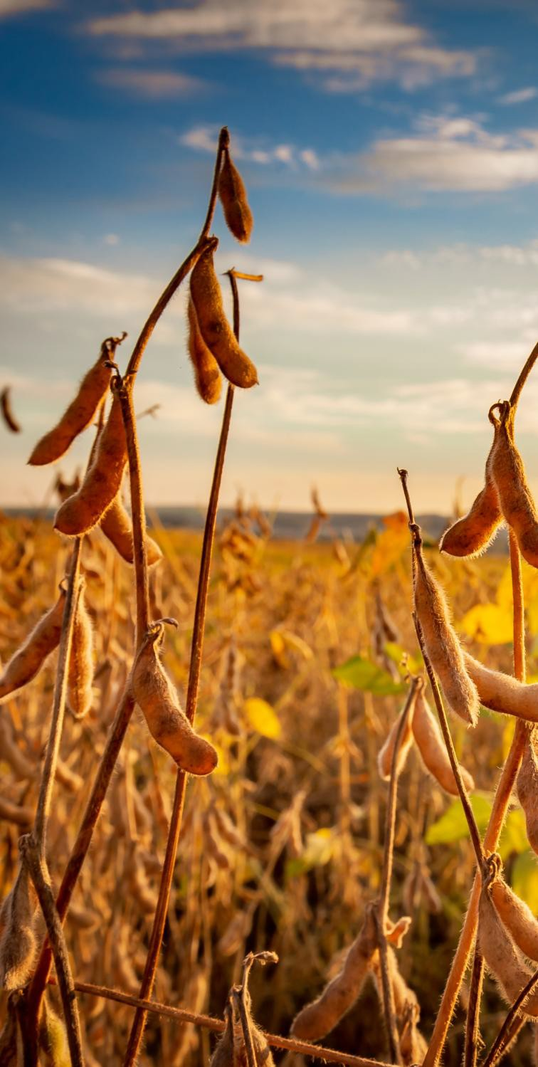
SESSION 1:
LAND TENURE – UNLOCKING THE FUTURE OF FARMING
Secure land access is the foundation of any successful farming enterprise. This session will feature a government presentation on land policy and the future vision for reform, followed by an open discussion exploring the critical role of title deeds, the practical challenges farmers face in accessing land, and the need for greater clarity on land reform intentions. Together, we will unpack solutions that can empower farmers to establish long-term security, unlock financing, and build thriving, generational businesses.

Slide 8

SESSION 2:
DE-RISKING THROUGH INSURANCE
Unpredictable weather and climate variability place enormous pressure on farmers, threatening both income and long-term sustainability. Crop insurance has become a vital risk management tool, protecting farmers against disasters such as drought, flooding, and hail, while enabling greater confidence in investment and production. This session will unpack the different types of insurance available — from yield-based and weather index products to multi-peril cover and short-term insurance — while also addressing the barriers of high premiums, low awareness, and limited uptake. By exploring practical solutions, this discussion will highlight how insurance
can safeguard farmers’ income, strengthen food security, and
unlock growth opportunities for the sector.

Slide 9
SESSION 3:
AGRICULTURAL BLENDED FINANCE SCHEMES
Access to affordable and appropriate finance remains one of the greatest barriers to rural agricultural development. This session will explore the mechanics and advantages of blended finance, showing how the combination of public and private funding can reduce investment risk, attract capital, and open doors for growth in the grain development sector.
Discussions will cover application pathways and eligibility, as well as the importance of financial readiness for farmers seeking to access these opportunities. Delegates will also gain insight into successful case studies of blended finance in action, with a forward look at future scaling opportunities. By addressing capital constraints and broadening access to credit, this session will promote inclusive growth, investment in grain development, and greater food security for South Africa.

Slide 10
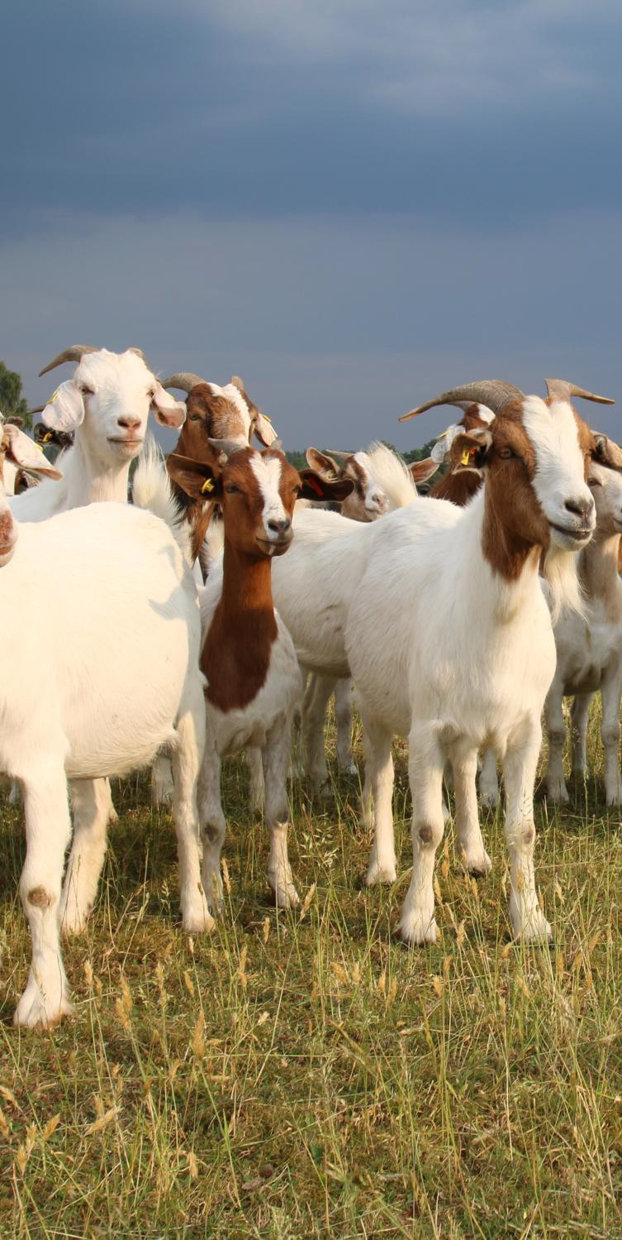
SESSION 4:
LIVESTOCK INTEGRATION, BALANCING THE ENTERPRISE
Diversification is key to building resilient farming operations. This session will explore the value of integrating livestock enterprises into grain farming as a means to stabilise income streams, strengthen cash flow, and reduce risk. Discussions will focus on practical solutions and investment strategies, the importance of biosecurity and animal health protocols, and building strong partnerships between government and grain farmers.
With a spotlight on livestock integration, delegates will unpack the “how” — from choosing the right breed and feed to managing animal health effectively. This session promises hands-on insights into making mixed farming a balanced, profitable, and sustainable enterprise.

Slide 11
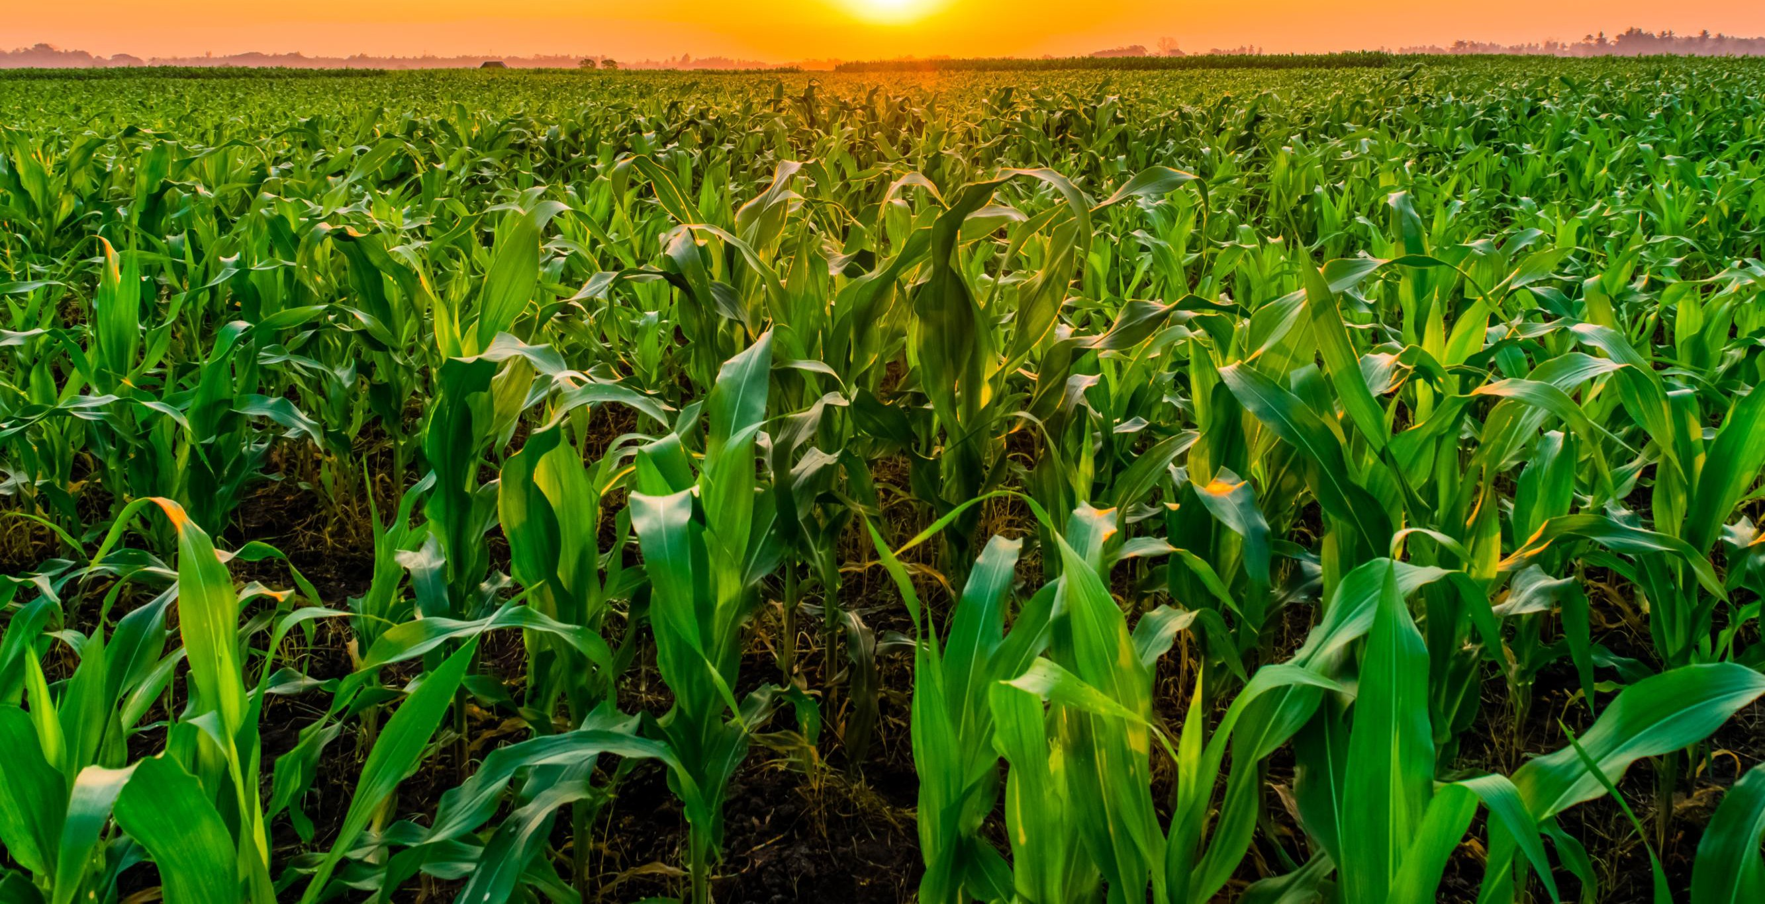
SMALL DEVELOPMENT FARMERS
BREAK-AWAY SESSIONS

Slide 12
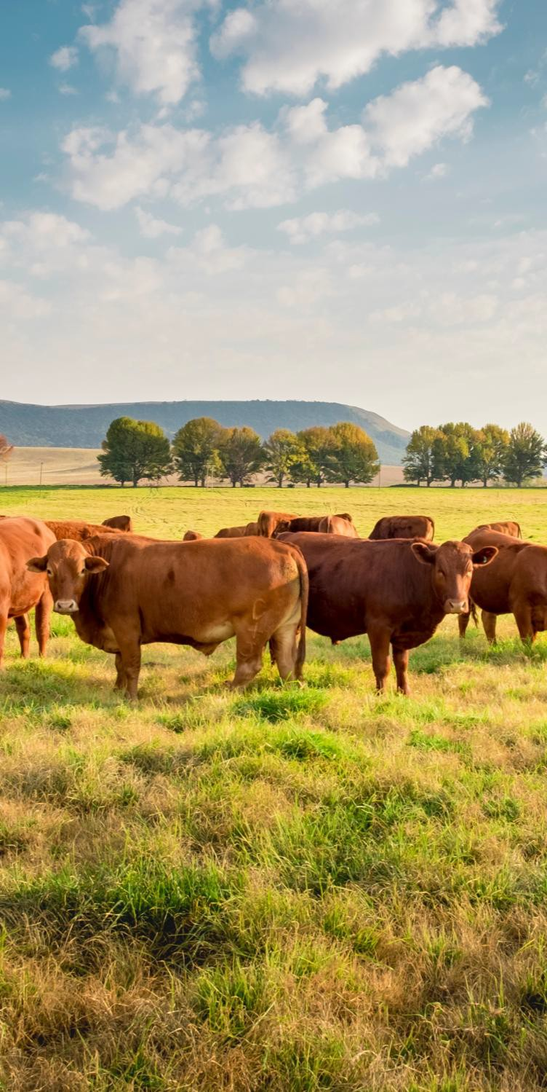
SMALL DEVELOPMENT FARMERS
While the four main conference sessions take place, there will also be dedicated break-away sessions for Small Development Farmers, facilitated by PGP regional managers and mentors. These interactive discussions will focus on the following crucial themes:
Quality of Inputs – ensuring access to reliable seed, fertiliser, and other essentials.
Mentorship and Extension Services – providing guidance and on-the- ground support for growth.
Grain Storage and Marketing – practical strategies tailored for small-
scale producers.
Financing – exploring pathways to affordable and accessible capital. Livestock Integration – covering animal health, feed, and nutrition for sustainable mixed farming.

Slide 13
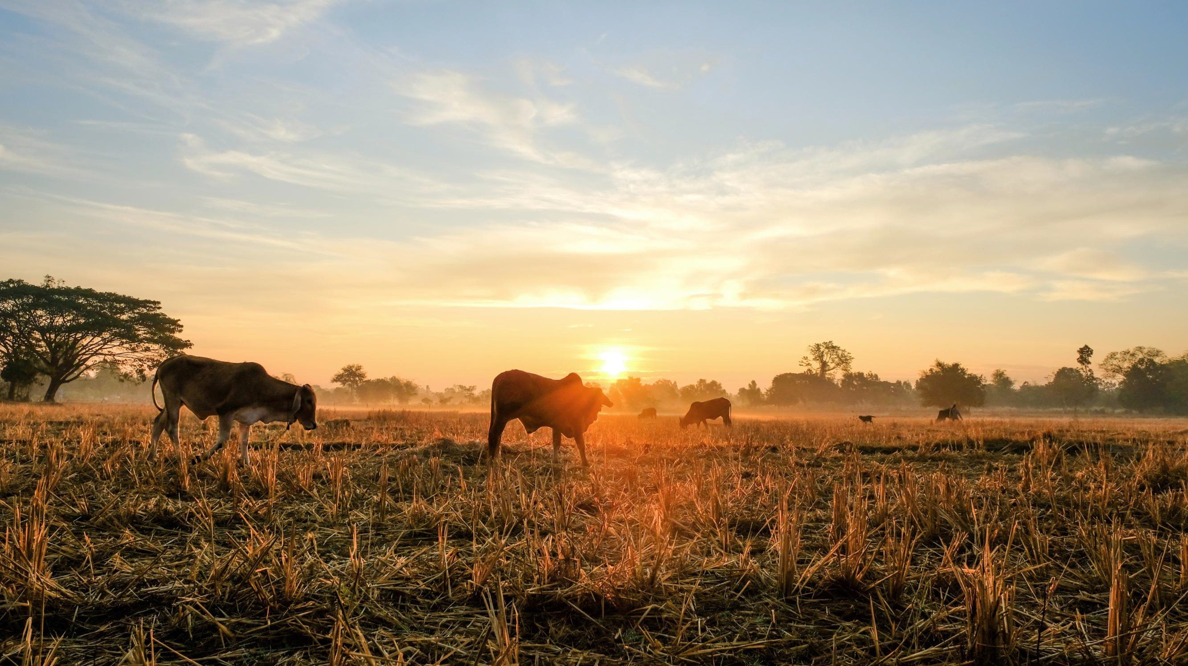

MEDIA PARTNERS

